Slide 1
Screen Interpreting Assistant(SIA)
MAJOR PROJECT TEAM NUMBER - 29
TEAM GUIDE:
CH. SATHISH KUMAR(Asst. prof)
TEAM MEMBER:
UDAY SANKAR GOTTIPALLI(S180443)

Slide 2
Table of Contents
1
2
3
Introduction
Abstract
Problem statement
4
5
6
Objectives
Scope
Advantages

Slide 3
Introduction
Despite of omnipresence of world wide web, web accessibility is still an issue. Web accessibility can be defined as how a user access the web content. Most of the websites are developed by neglecting physically handicapped users. This project is to help visually impaired people to access the any websites easily.
The reason we are focusing on e-commerce websites is, it provides a wide scope of conversing, also internal navigation within the website.

Slide 4


Abstract
Websites have huge and valuable amounts of information in a transactional format. Developing websites which are accessible to all the users has become a priority. Thus, everyone can use the internet and experience their true potential. Despite visually elegant websites, accessible for visually impaired people is complicated.

Slide 5
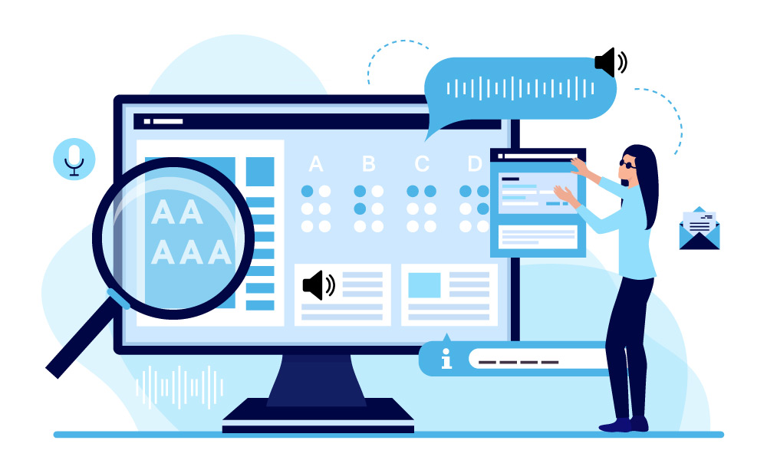
Screen readers (SRs) made much of this information available to visually impaired users. However, since their development, screen readers have offered only limited access to all information on the web page. Often these screen readers either be verbose or skim through information which is biased by accessibility of the website. The handling of SRs comes with numerous and complicated keyboard commands and shortcut keys.

Slide 6
Voice assistants (VAs) work comparatively better than screen readers in terms of interaction. They interact vocally using voice commands and perform tasks based on the keywords identified in the conversation. Existing systems of voice assistants have limited modular features as reading out the contents of the webpages.

Slide 7
Webpages differ from each other in different ways such as in structure, design, content, and HTML elements. This project is about making a voice assistant that can analyze any type of website and understand its contents. This project helps in obtaining the information from the webpages and perform required actions on webpage through user voice command. Through this assistant, users can interact with websites with only voice commands, which helps visually impaired users effectively.

Slide 8
Problem Statement
Develop an advanced voice assistant that aids visually impaired users by enabling them to navigate a website through voice commands. The voice assistant will facilitate various operations, providing the visually impaired with the same browsing capabilities as any sighted individual.

Slide 9
Objectives of the Project
Understanding the inside contents of any webpage
1
The major objectives of the project includes:
Understanding the user requirements through voice commands
2
The Assistant should be able understand the contents of
different types of websites.
The Assistant should be able to comprehend the user
needs and perform accordingly.
Performing the task on the website automatically.
Extracting the relevant information from the webpage
3
4
The Assistant should be able handle event on the page to
perform various tasks according to user needs.
The Assistant should be able handle event on the page to
perform various tasks according to user needs.
Such as signing up to a webpage, login
Maintaining the user privacy
Build a portable hardware to access the Assistant anywhere
5
6
The user’s private information such as passwords should be
kept protected.
The assistant is a portable device as Alexa or Siri, should be
able to connect the cloud to access the http information.

Slide 10
Future Scope of SIA
The Project can be extended to:
Provide accessibility to all type of disabled people.
Provide accessibility of any type of screen
Automatic monitor control.
Scene interpretation.

Slide 11
Thank You
UDAY SANKAR GOTTIPALLI
S180443

